Slide 1


TRICS Guidance Note:
Practical Implementation of the Decide and Provide
Approach
Lynn Basford BasfordPowers Ltd
Glenn Lyons UWE / Mott MacDonald
Nick Rabbets TRICS

Slide 2
Purpose of the Presentation
To set out the guidance.
Show the journey of developing the Decide and Provide Principles.
Set out what is the Decide and Provide Process and its component parts.
How to use TRICS and the Decide and Provide.

Slide 3
Scene setting

Slide 4

Changing travel behaviour
Would you tell me, please, which way I ought to go from here?

Slide 5
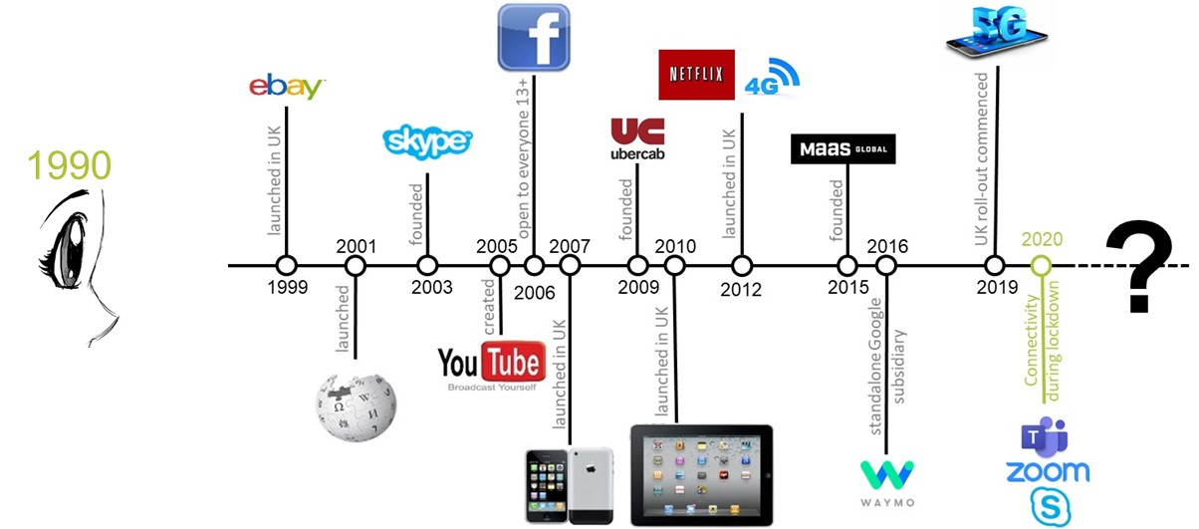
What change we have seen

Slide 6
It’s the need for access, stupid
Land Use System
Spatial
Proximity
“Transport does not merely serve society: it shapes society, as in turn society shapes transport”
Accessibility
Transport
System
Telecommunications
System
(Lyons, 2004)
Physical
Mobility
Digital
Connectivity

Slide 7


A state of flux and a need for change
Global shock
Preferred future

Slide 8
From predict and provide to decide and provide
demand-led supply ● reactive
supply-led demand ● proactive
Predict and provide – forecast a most likely mobility future (within sensitivity-tested bounds of uncertainty) and provide a means to accommodate projected demand
Decide and provide – decide on a preferred accessibility future (and outcomes) and provide a means to move towards it in a way that accommodates the deep uncertainty ahead

Slide 9
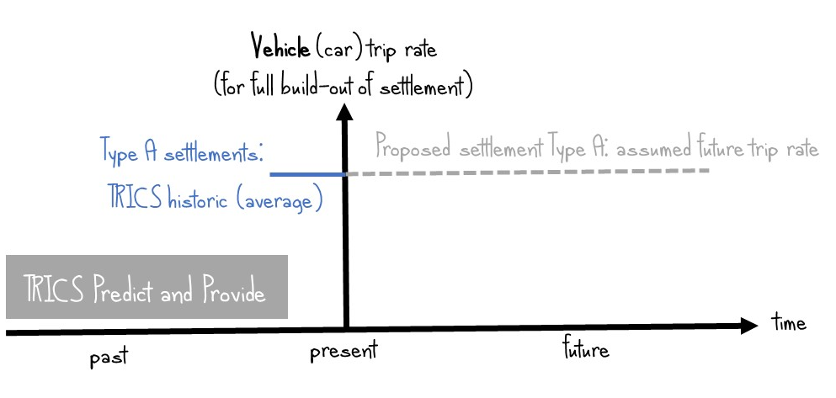
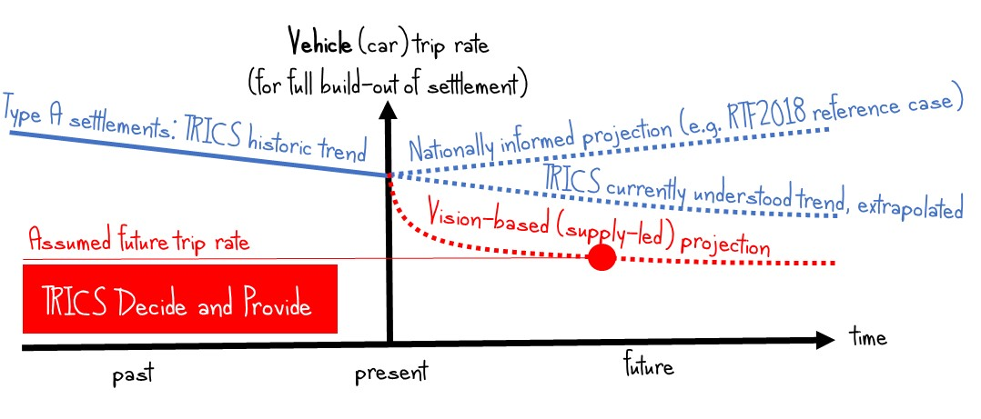
TRICS – it’s how you use it that matters
TRICS data depict the past, not the future
The past and future can be interpreted differently
Remember that any attempt to project future trip rates is a judgement based upon assumptions

Slide 10
Guidance Note

Slide 11



Purpose
To inform plan making and related strategic land use and transport planning
To support and assist the practical implementation of the Decide and Provide Approach in the preparation, and review of transport appraisals, including Transport Assessment and Transport Statements
To maximise the use of TRICS’s bank of survey data to best effect
To address the lack of guidance in this area and,
To support and reflect the ongoing paradigm shift
The Guidance challenges orthodox wisdom and practices

Slide 12
Why is the Guidance needed?
TRICS should be used in a way that responds to the significant changes in social, economic, technological and environmental drivers which impact on land use and transport planning; and in a way that responds to societal imperatives.
There is a change or transition taking place in the transport planning industry that is characterised by a paradigm shift from the Predict and Provide approach to the Decide and Provide approach.
There is a real lack of guidance in this area, particularly for the production of transport assessments and statements.
There are very REAL risks of sticking with the Predict and Provide approach, which include: not supporting Net Zero; under provision of walking and cycling facilities; and the over provision of highway capacity.

Slide 13
What is the Decide and Provide approach?
Decide and Provide is to:
  Decide on the preferred future and provide the means to work towards that which can accommodate uncertainty.
  It allows us to:
  Adopt a more positive and integrated transport and land use planning approach
  Achieve more meaningful implementation of a modal hierarchy that prioritises walking, wheeling and cycling
  Better support the decarbonisation of transport

Slide 14
What is the Decide and Provide approach?
Decide and Provide involves:
  Visioning
  Acknowledging deep uncertainty
  Scenario Planning
  Understanding the quantum, scale and mix of proposed development
  Using trends and historic trend data

Slide 15
Visioning

Slide 16
What is the approach?
Visioning:
  Central to place making and creating better places to live, work and play (shaping not serving)
  Three overarching key questions for visioning are:
    What sort of place are we creating?
    What kind of activities do we need or desire to travel for?
    How will we provide for mobility?
    Transport planners need to understand, influence and share the vision that land use planners have for a place (for a plan) or for a specific site (for a project)

Slide 17
Probing for Better Planning
What can the ratio of new homes and new jobs be? (taking into account proximity and provision)
What can the provision of local retail and community services be ?
What can the work from home provision, including broadband infrastructure be?
What can the relationship to existing education services and/or the provision of new educational facilities be?
What can the active travel provision, including the provision of new (or upgrade of existing) pedestrian and cycle infrastructure be ?

Slide 18
Probing for Better Planning
6. What can the public transport and shared mobility provision, existing, upgraded and new be?
7. What can the specific provision for electric and other ultra-low emission vehicles be?
8. What can the parking provision for all vehicular modes be?
9. What can the physical layout of the site, including levels of accessibility and permeability be?
10. How could these factors affect the trip rates?

Slide 19
Scenario Planning

Slide 20
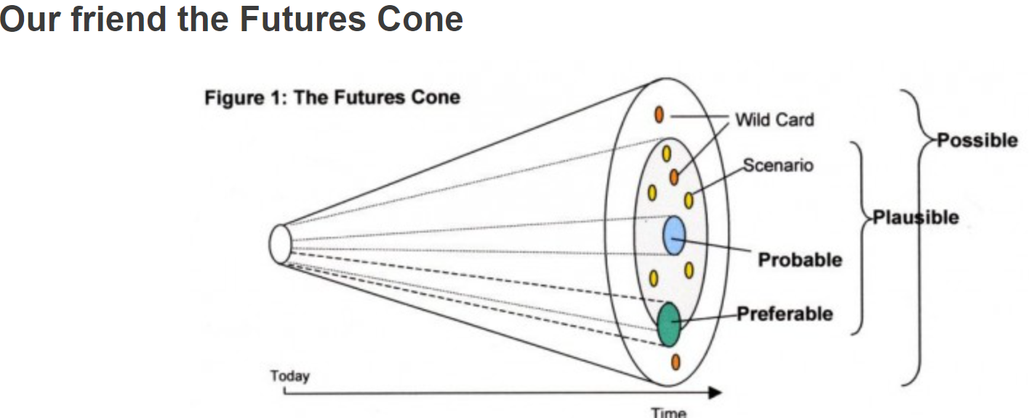
What is scenario planning?
Scenario planning is contrasted with trend extrapolation and traditional forecasting, which, while commonly used in attempting to understand the impacts of proposed developments, conceals uncertainty and gives misplaced confidence in the future state.
We need to reconcile a preferred future vision and plausible futures.
We are moving to a “decide and provide” approach rather than the traditional “predict and provide” approach which takes as its base assumption that people will maintain past and current travel behaviour.

Slide 21
How many scenarios do you need?
The number of scenarios needed will be a matter of professional judgement.
This Guidance suggests that three different and plausible scenarios typically be considered.
For example:
  Scenario 1 – Department for Transport Road Traffic Forecast 2018 Scenario 1 (Reference) using current trip rates taken from TRICS. (Full Fat) Not Future Policy
  Scenario 2 – Department for Transport Road Traffic Forecast 2018 Scenario 6 (Extrapolated Trip Rates) (Semi Skimmed)
  Scenario 3 – Department for Transport Road Traffic Forecast 2018 Scenario 6 (Extrapolated Trip Rates) using adjusted trip rates taken from TRICS which take account of increased internalisation, increased working from home and low/zero carbon initiatives. (Skimmed)
  Additional scenarios can be produced that take into account phasing and implementation
  Use the Scenario Fan to show the difference in outcomes with the various scenarios.

Slide 22
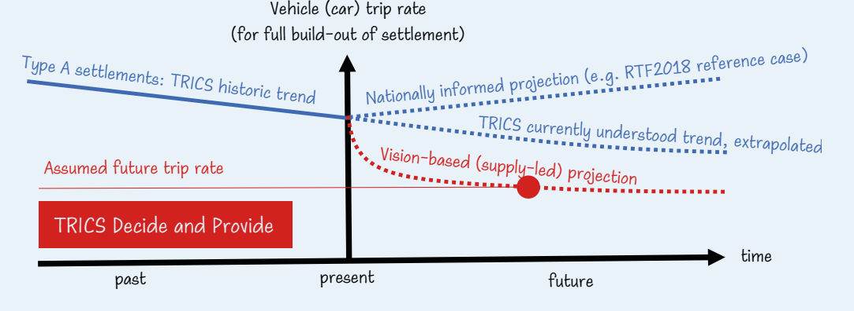
The results: the Scenario Fan

Slide 23
Acknowledging deep uncertainty in making your case

Slide 24

Acknowledging uncertainty in making your case
Increasing acknowledgement of deep uncertainty:
  Changes in consumer behaviour lead to uncertainty
  Pandemic and other interruptors
  Need to state what uncertainty has been taken into account in assessing development impacts
  Use evidence; trends and historic trend data to reflect and report on uncertainties.
  Adds resilience to decision making
  Make the case for the design of the settlement to be resilient.
  HAVE YOU ACKNOWLEDGED UNCERTAINTY?

Slide 25

Is Decide and Provide appropriate for all planning matters?
Yes!
  Site specific, Local Plans, Local Transport Strategies
  Parameters required – scale, sensitivity & complexity

Slide 26
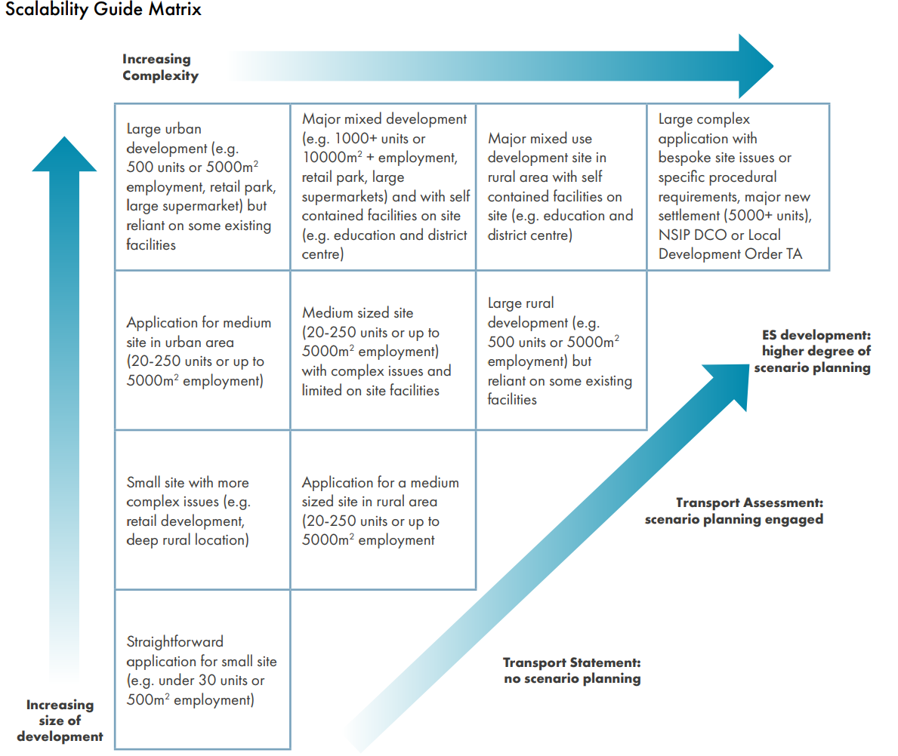
Scalability Guide Matrix

Slide 27
A Deep Dive for the TRICS User

Slide 28
Using TRICS Database to Decide and Provide
TRICS Database contains survey data going back to the beginning of the 1990’s
Multi-modal data collected since January 2000
The survey data is a record of travel behaviour for each site on the day of survey
Myth – “TRICS promotes Predict and Provide culture”
  The database is a record of survey information.
  It’s the way people choose to use this data which is important.
  Changing the way the information is used can promote Decide and Provide.

Slide 29
Historic trends
Decide and Provide acknowledges what has happened in the past and uses trend information to inform the future.
The number of surveys within TRICS allows analysis of surveys to be filtered and output so they can be used to display historic trends.
TRICS has suggested a procedure to undertake this, which follows the recommendations within the Decide and Provide Guidance Note.
Excel Historic Trend Template available from http://www.trics.org/decideandprovideguidance.html

Slide 30
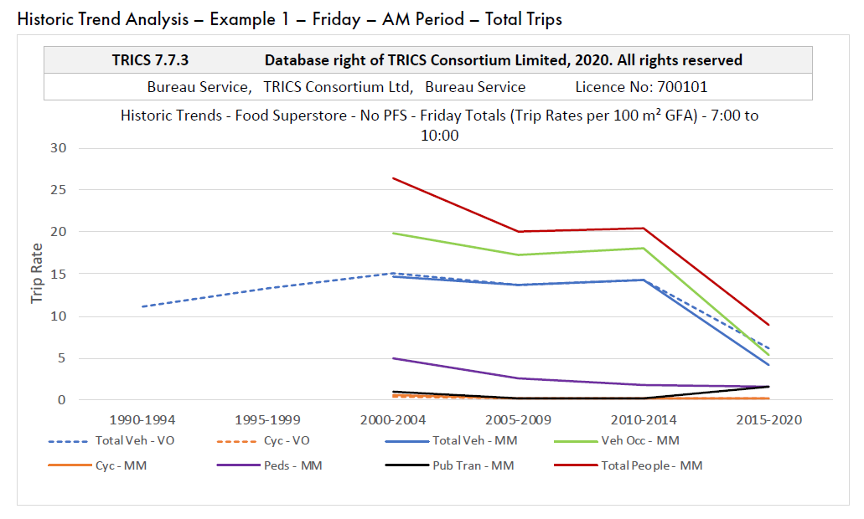
Historic trends
Notes of explanation for Graph:
VO – Data obtained from Vehicle Only data
MM – Data obtained from Multi-Modal Data
PFS – Petrol Filling Station
Data within the graph is obtained from multiple TRICS sites, all within the same parameters set by the user. Each time slice will contain a different mixture of sites that all meet the defined parameters.

Slide 31
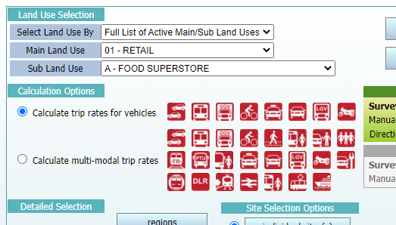
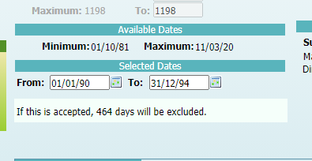
Historic trends analysis
Working left to right:
1st Filtering screen – Firstly analyse/calculate for all Vehicle Only segments then all Multi-Modal segments.
2nd Filtering screen – select your Primary Filters that replicate your site and then change the date range at the bottom to reflect your timeslice requirements, work to 5 year intervals, but if you have a good sample size this could be reduced to 4 years or even smaller if required. Keep filtering parameters the same for EVERY calculation undertaken for that trend analysis. Use of the TRICS Good Practice Guide should be followed in relation to site selection, as you would for a usual TRICS analysis. 2021 Good Practice Guide

Slide 32
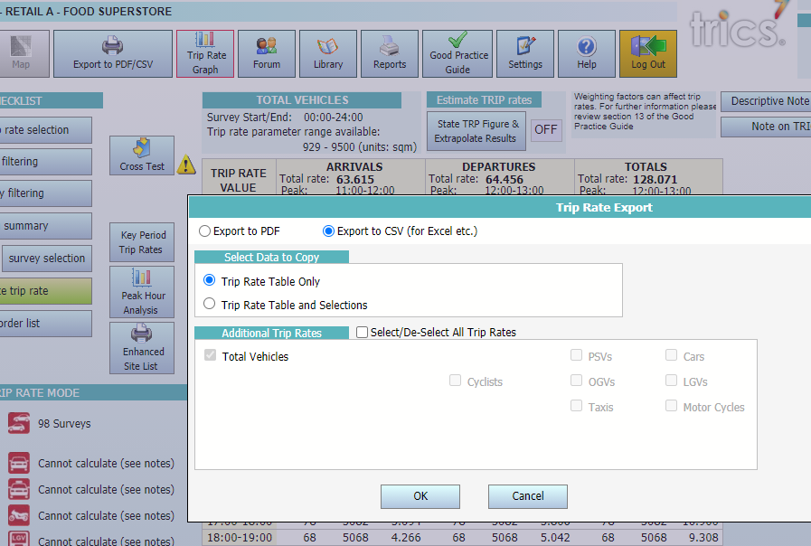
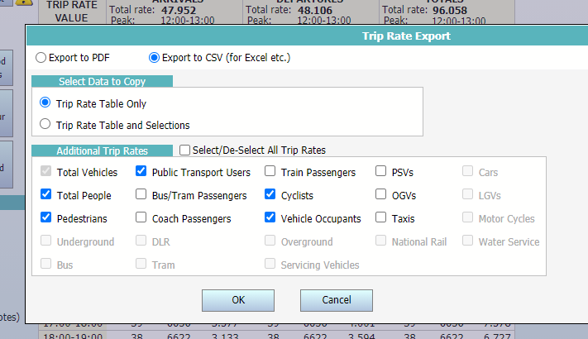
Historic trends analysis

Slide 33
Historic trend analysis
Within the Trip Rate Calculation page select ‘Export to PDF/CSV’ and select the modes required for the Historic Output
The TRICS Template for creating the output has been designed for the following Trip Rate Modes:
Vehicle Only Calcs – Total Vehicle & Cycles (where these are available)
Multi-Modal Calcs – Total Vehicles, Cycles, Vehicle Occupants, Pedestrians, Public Transport & Total People
Create Outputs in both CSV (for import into the Excel Template) and PDF for reporting purposes
Once output into these formats you can then import the CSV into the Excel Template and return to the Primary Filtering Screen to adjust your date range

Slide 34
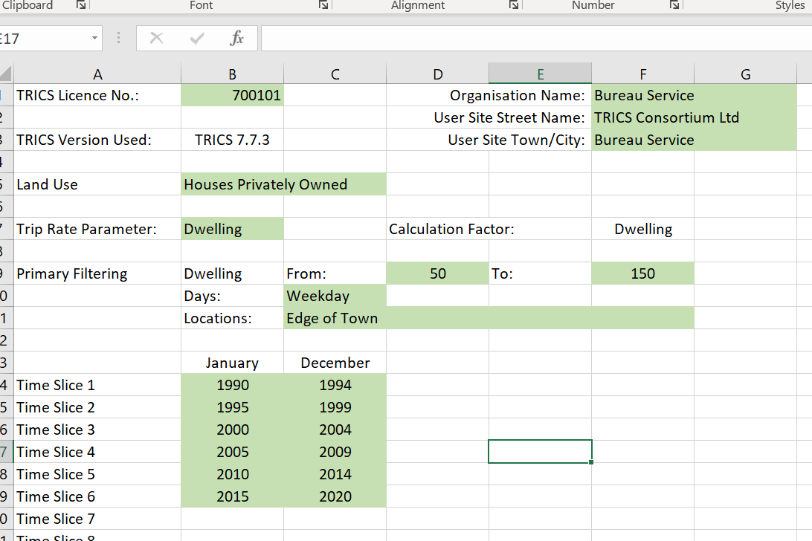
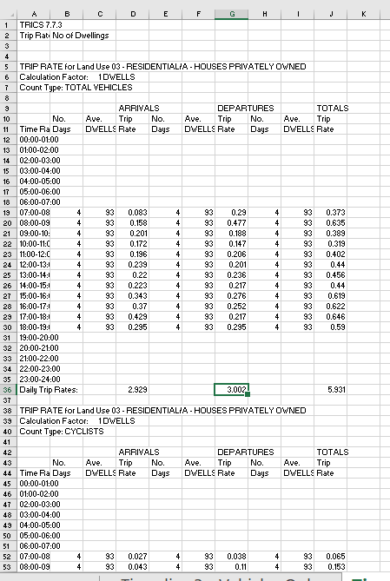
Historic trends Excel template
Data from CSV file then copied into relevant Timeslice TAB within Excel
If output correctly, as outlined within the Instructions Page, all data should be in correct format and in the correct order for plotting to a Graph
Green Area for users to keep notes on Parameters used during TRICS Analysis
Due to Multi-Modal data only starting in 2000 you note that we will have no data for these Travel Modes for the first 2 time slices

Slide 35
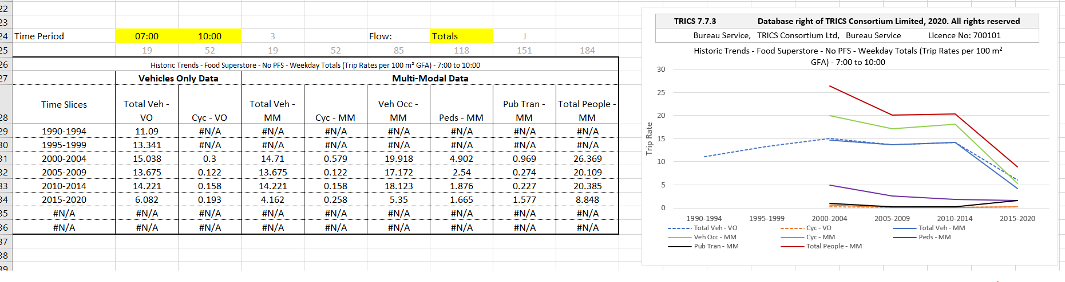
Historic trend analysis
The Trends Output page can then be used to view different information by changing the drop down boxes highlighted yellow.
The first 2 yellow boxes enable the user to select a time period anything from 1 hours to the complete day.
The third box allows the user to select Arrivals, Departures or Totals
There are 4 graphs available for the display of data within the Template, but more can be easily added if you are competent with Excel formula
You can then copy and paste the information from this page into your Word documents as required.

Slide 36
The Next Stages for TRICS in brief
Historic Trend work shows what has been happening to the change in travel behaviours for the Land Use examined. So we can see what has lead to the current situation.
A Standard TRICS Analysis is then undertaken to create an picture of what could be expected if the site were built today and thus create your base scenario.
Your knowledge of observed Historic Trends, DfT Forecasts and the Site Design Features can then be used to home in on the plausible forecast scenarios. These will give you a fan of influence that can be discussed between parties, with one or two (or more) of these scenarios being fully tested and examined (the number being dependant upon the scale of development and the sensitivity of the surrounding Travel Network).

Slide 37
Decide & Provide Doesn’t Stop at Construction
Monitoring is an extremely important element of the D&P process. As Transport Professionals how do we know what is working and what is not?
How many of you have been back to a site you were involved with 10 years ago to physically record the Travel Behaviours, to see if your assumptions were correct?
We need to ensure that every £ spent on constructing a development is value for money and worthwhile for the local population.
Without proper independent monitoring we could all be following the wrong path and making things worse, or at best, not improving them as much as we thought.
The use of TRICS SAM process can support and strengthen the Monitoring and Evaluation Plan. Independent monitoring surveys with the provision of standardised, unbiased survey data that adds to the evidentiary base.

